Slide 1
Boolean algebra

Slide 2
Operations on bits

Slide 3
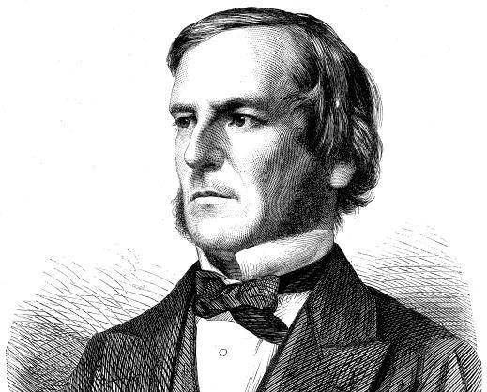

Boolean algebra
The study of the kinds of operations that can be carried out on bits is called Boolean algebra.
George Boole (1815-1864)
Claude Shannon (1916-2001)
Developed the rules of logic.
Showed how to use this for designing computer circuits.

Slide 4







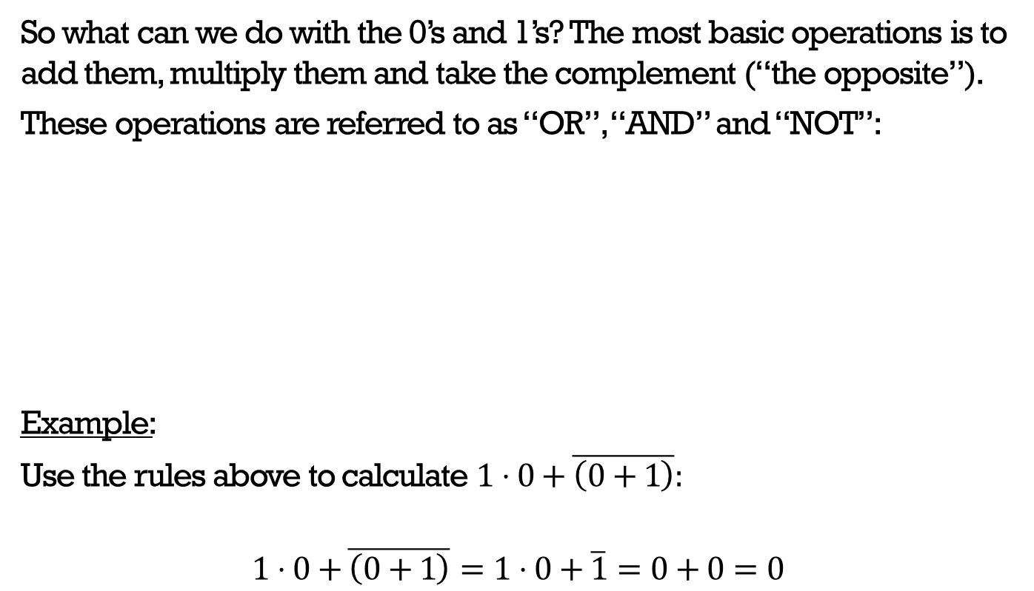









Basic Boolean operators
So what can we do with the 0’s and 1’s? The most basic operations is to add them, multiply them and take the complement (“the opposite”).
These operations are referred to as “OR”, “AND” and “NOT”:
Example:
Use the rules above to calculate $1⋅0+\overline{\left(0+1\right)}:$
$$1⋅0+\overline{\left(0+1\right)}=1⋅0+\overline{1}=0+0=0$$
OR
AND
NOT
$$0+0=$$
$$0$$
$$0⋅0=$$
$$0$$
$$0+1=$$
$$1$$
$$0⋅1=$$
$$0$$
$$\overline{0}=$$
$$1$$
$$\overline{1}=$$
$$0$$
$$1+1=$$
$$1$$
$$1⋅1=$$
$$1$$

Slide 5









Additional Boolean operators
In addition to the basic operators from the last slide, we will also occasionally meet the “Not AND (NAND)”, “Not OR (NOR)” and “Exclusive OR (XOR)” operators:
NAND
NOR
XOR
$$0↑0=1$$
$$0↓0=1$$
$$0⊕0=0$$
$$0↑1=1$$
$$0↓1=0$$
$$0⊕1=1$$
$$1↑1=0$$
$$1↓1=0$$
$$1⊕1=0$$

Slide 6

Boolean variables
A Boolean variable is a variable which can only take the values $0$ or $1$. We will typically use $x$, $y$ and $z$ as our Boolean variables.

Slide 7
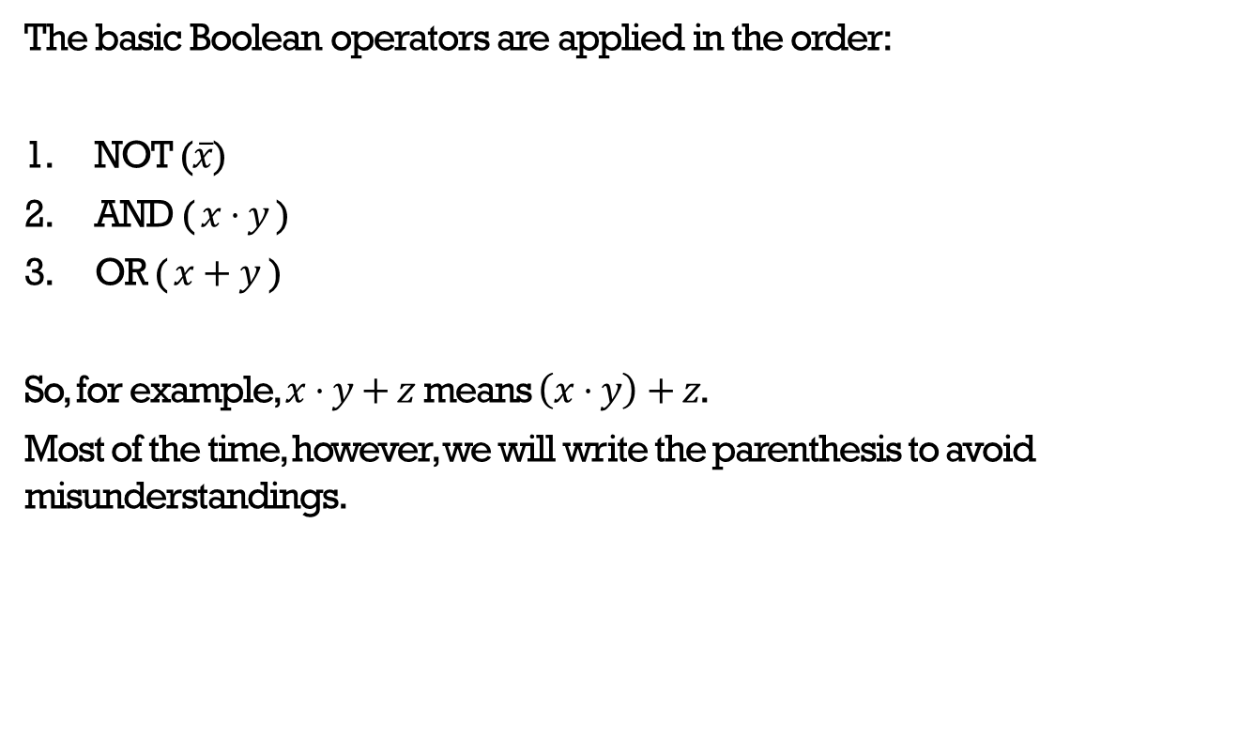
Order of Boolean operators
The basic Boolean operators are applied in the order:
NOT ($\overline{x}$)
AND ($x⋅y$)
OR ($x+y$ )
So, for example, $x⋅y+z$ means $\left(x⋅y\right)+z$.
Most of the time, however, we will write the parenthesis to avoid misunderstandings.

Slide 8
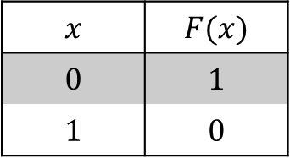
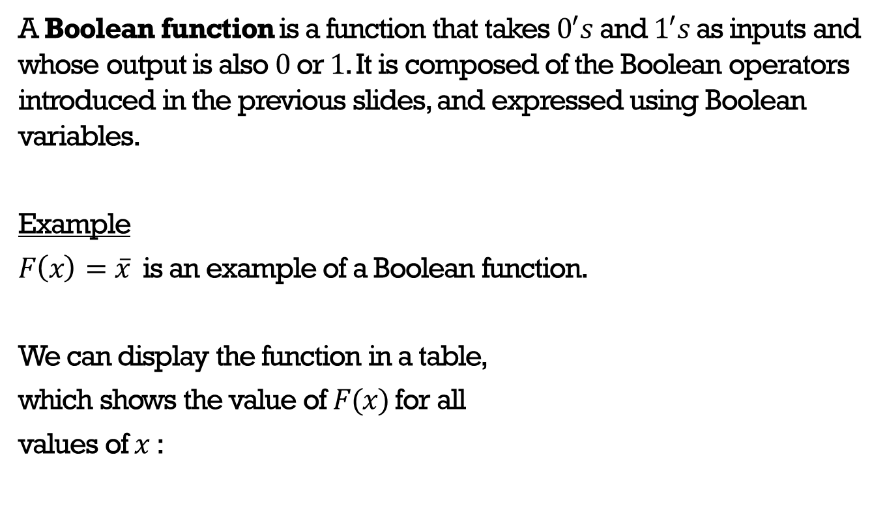
Boolean functions
A Boolean function is a function that takes $0^{′}s$ and $1^{′}s$ as inputs and whose output is also $0$ or $1$. It is composed of the Boolean operators introduced in the previous slides, and expressed using Boolean variables.
Example
$F\left(x\right)=\overline{x}$ is an example of a Boolean function.
We can display the function in a table,
which shows the value of $F(x)$ for all
values of $x$ :
$$x$$ | $$F(x)$$
$$0$$ | $$1$$
$$1$$ | $$0$$

Slide 9
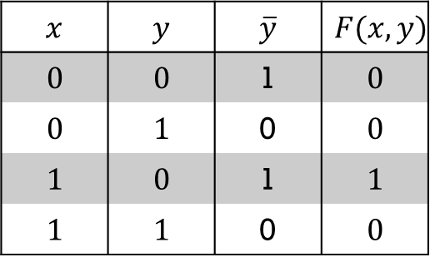

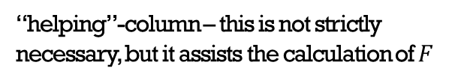
Example: A Boolean function of two variables
$$F\left(x,y\right)=x\overline{y}$$
Below, the function is displayed in a table, which shows the value of $F$ for all combinations of values of the inputs $x$ and $y$:
$$x$$ | $$y$$ | $$\overline{y}$$ | $$F(x,y)$$
$$0$$ | $$0$$ | 1 | $$0$$
$$0$$ | $$1$$ | 0 | $$0$$
$$1$$ | $$0$$ | 1 | $$1$$
$$1$$ | $$1$$ | 0 | $$0$$
“helping”-column – this is not strictly necessary, but it assists the calculation of $F$

Slide 10
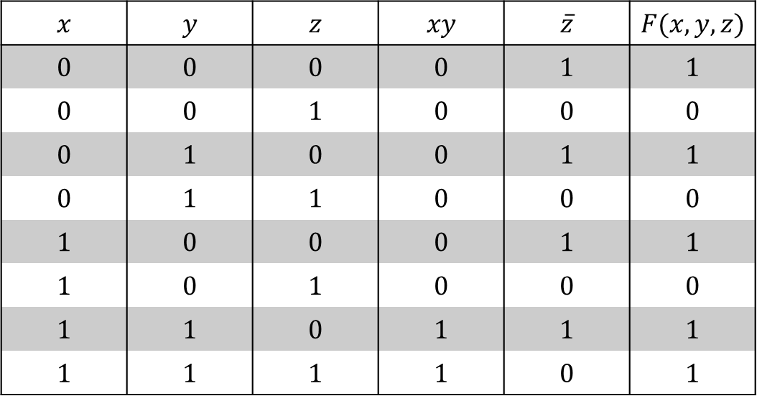

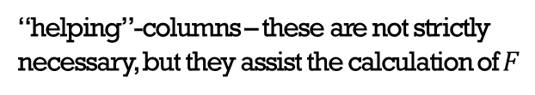
Example: A Boolean function of 3 variables
$$F\left(x,y,z\right)=xy+\overline{z}$$
The function is displayed in the table below, which shows the value of $F$ for all combinations of the input values $x$, $y,$and $z$:
$$x$$ | $$y$$ | $$z$$ | $$xy$$ | $$\overline{z}$$ | $$F(x,y,z)$$
$$0$$ | $$0$$ | $$0$$ | $$0$$ | $$1$$ | $$1$$
$$0$$ | $$0$$ | $$1$$ | $$0$$ | $$0$$ | $$0$$
$$0$$ | $$1$$ | $$0$$ | $$0$$ | $$1$$ | $$1$$
$$0$$ | $$1$$ | $$1$$ | $$0$$ | $$0$$ | $$0$$
$$1$$ | $$0$$ | $$0$$ | $$0$$ | $$1$$ | $$1$$
$$1$$ | $$0$$ | $$1$$ | $$0$$ | $$0$$ | $$0$$
$$1$$ | $$1$$ | $$0$$ | $$1$$ | $$1$$ | $$1$$
$$1$$ | $$1$$ | $$1$$ | $$1$$ | $$0$$ | $$1$$
“helping”-columns – these are not strictly necessary, but they assist the calculation of $F$

Slide 11
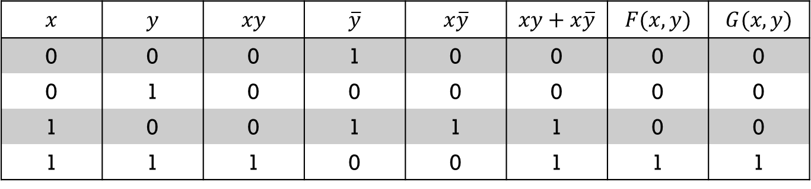
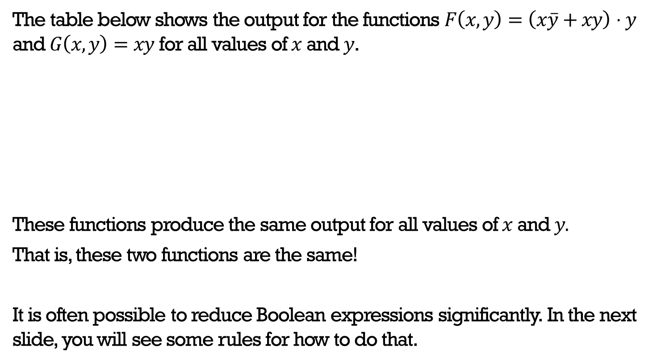
Simplifying a Boolean expression
The table below shows the output for the functions $F\left(x,y\right)=\left(x\overline{y}+xy\right)⋅y$ and $G\left(x,y\right)=xy$ for all values of $x$ and $y$.
These functions produce the same output for all values of $x$ and $y.$
That is, these two functions are the same!
It is often possible to reduce Boolean expressions significantly. In the next slide, you will see some rules for how to do that.
$$x$$ | $$y$$ | $$xy$$ | $$\overline{y}$$ | $$x\overline{y}$$ | $$xy+x\overline{y}$$ | $$F(x,y)$$ | $$G(x,y)$$
0 | 0 | 0 | 1 | 0 | 0 | 0 | 0
0 | 1 | 0 | 0 | 0 | 0 | 0 | 0
1 | 0 | 0 | 1 | 1 | 1 | 0 | 0
1 | 1 | 1 | 0 | 0 | 1 | 1 | 1

Slide 12



Boolean identities
Commutative laws:
$x+y=y+x$, $x⋅y=y⋅x$
Absorption laws:
$x+x⋅y=x$
$x⋅\left(x+y\right)=x$
De Morgan’s laws:
$\overline{\left(x⋅y\right)}=\overline{x}+\overline{y}$
$\overline{\left(x+y\right)}=\overline{x}⋅\overline{y}$
Double complement:
$\overset{̿}{x}=x$
Idempotent laws:
$x+x=x$, $x⋅x=x$
Identity laws:
$x+0=x$, $x⋅1=x$
Domination laws:
$x+1=1$, $x⋅0=0$
Unit property:
$\overline{x}+x=1$
Zero property:
$\overline{x}⋅x=0$
Associative laws:
$x+\left(y+z\right)=\left(x+y\right)+z$
$x⋅\left(y⋅z\right)=\left(x⋅y\right)⋅z$
Distributive laws:
$x+y⋅z=\left(x+y\right)⋅(x+z)$
$x⋅\left(y+z\right)=x⋅y+x⋅z$

Slide 13
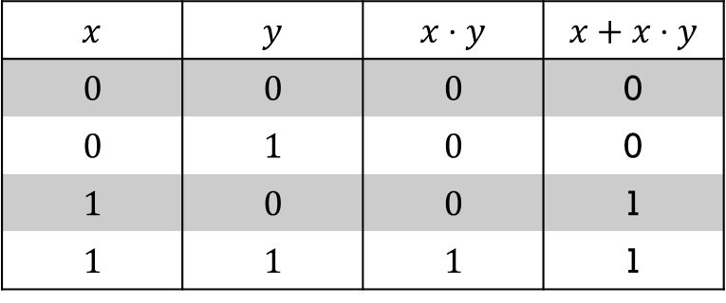
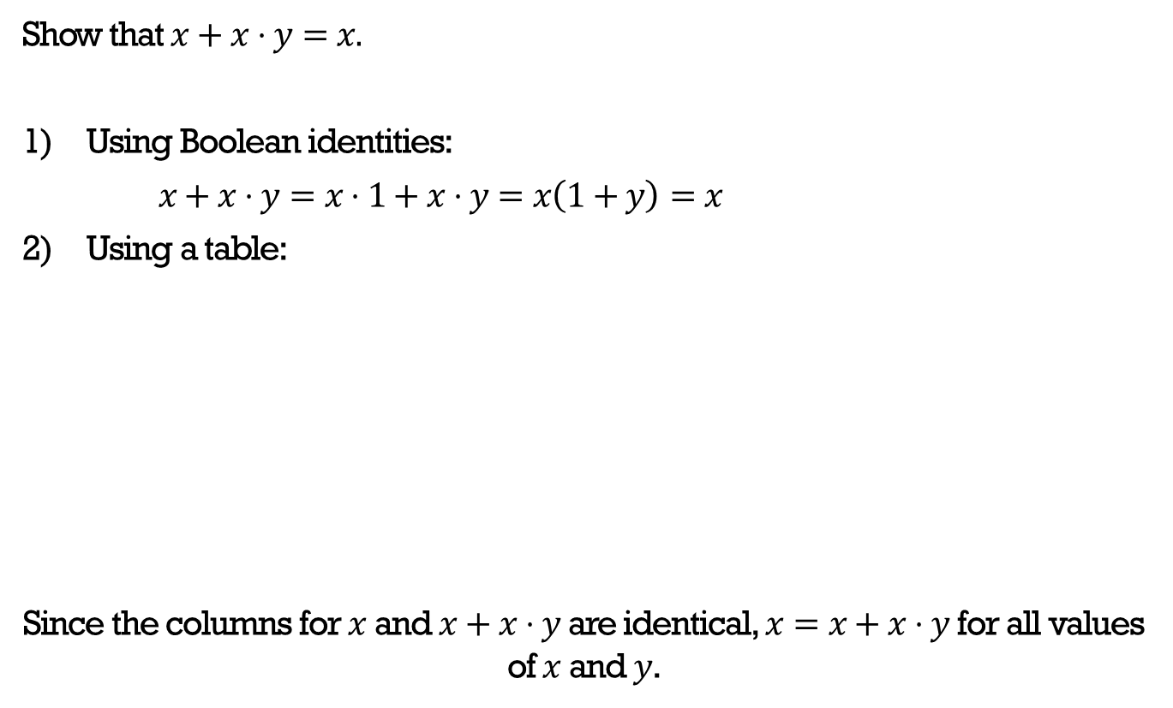
Example
Show that $x+x⋅y=x.$
Using Boolean identities:
$x+x⋅y=x⋅1+x⋅y=x\left(1+y\right)=x$
Using a table:
Since the columns for $x$ and $x+x⋅y$ are identical, $x=x+x⋅y$ for all values of $x$ and $y$.
$$x$$ | $$y$$ | $$x⋅y$$ | $$x+x⋅y$$
$$0$$ | $$0$$ | $$0$$ | 0
$$0$$ | $$1$$ | $$0$$ | 0
$$1$$ | $$0$$ | $$0$$ | 1
$$1$$ | $$1$$ | $$1$$ | 1

Slide 14
Creating circuits for Boolean functions

Slide 15
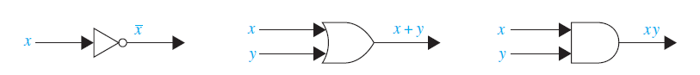
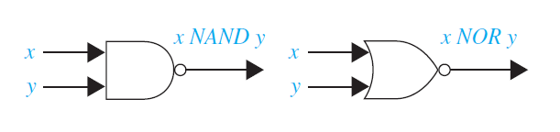




Logic gates
Each of the Boolean operations we have studied so far are represented in circuits using the symbols below.
OR
AND
NOT gate
OR gate
AND gate
$$x↑ y$$
$$x↓y$$
$$x⊕y$$
NAND
NOR
XOR
NAND gate
NOR gate
XOR gate

Slide 16
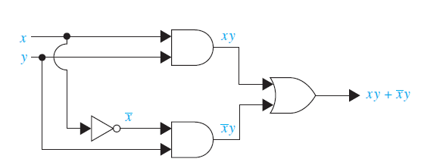

Example: Logic circuits
Using the logic gates from the previous slide, we can build circuits which represent any given Boolean function.
For example, the Boolean function $F\left(x,y\right)=xy+\overline{x}y$ can be represented with the ciruit below.
AND
OR
AND

Slide 17
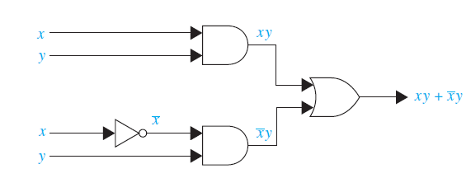
Logic circuits
AND
OR
AND
Two ways of drawing the same circuit!
AND
OR
AND

Slide 18

Logic circuits
We can also have more than two inputs to a gate:
AND
OR

Slide 19
Logic gates in computers

Slide 20
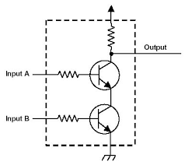
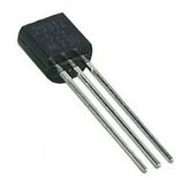
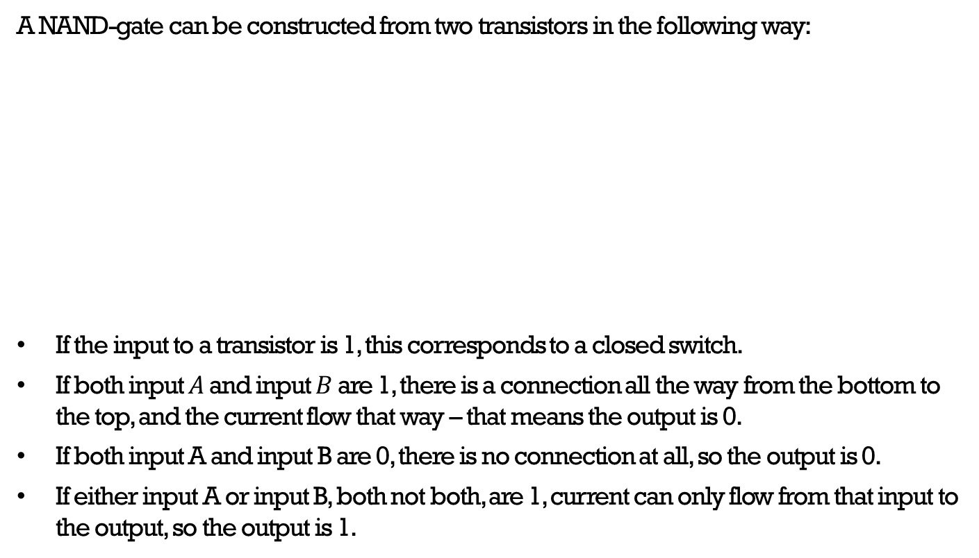
Logic gates in computers
A NAND-gate can be constructed from two transistors in the following way:
If the input to a transistor is 1, this corresponds to a closed switch.
If both input $A$ and input $B$ are 1, there is a connection all the way from the bottom to the top, and the current flow that way – that means the output is 0.
If both input A and input B are 0, there is no connection at all, so the output is 0.
If either input A or input B, both not both, are 1, current can only flow from that input to the output, so the output is 1.

Slide 21

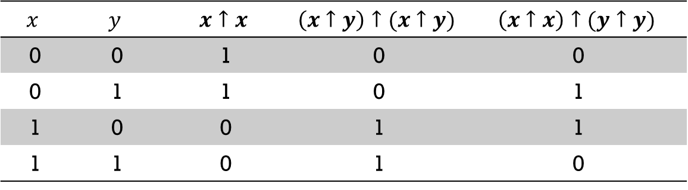


Functional completeness
The table below shows that all the basic Boolean operations can actually be represented using only NAND-gates (and so can NOR and XOR) – therefore, we say that the NAND-gate is functionally complete.
Since we have just seen how to build a NAND-gate using transistors, you now know how all the functions we have considered could be represented with transistors in a computer!
$$x$$ | $$y$$ | $$x↑x$$ | $$\left(x↑y\right)↑(x↑y)$$ | $$\left(x↑x\right)↑(y↑y)$$
0 | 0 | 1 | 0 | 0
0 | 1 | 1 | 0 | 1
1 | 0 | 0 | 1 | 1
1 | 1 | 0 | 1 | 0
NOT: $\overline{x}$
AND: $x⋅y$
OR: $x+y$

